Slide 1
Employee Data Analysis using Excel
STUDENT NAME: LOKAVARSHINI S
REGISTER NO: 312216985
[ 386560C6EFDE5ABAEC143ACE4014B690 ]
DEPARTMENT: B.Com ( General )
COLLEGE : Shri Krishnaswamy College for Women

Slide 2
PROJECT TITLE
Visualising Employee Attendance trends with Excel Charts

Slide 3


AGENDA
Problem Statement
Project Overview
End Users
Our Solution and Proposition
Dataset Description
Modelling Approach
Results and Discussion
Conclusion
3/21/2024 Annual Review

Slide 4

PROBLEM STATEMENT
1. Organizations face challenges
2. Raw data in tables lacks clarity
3. Difficulty in detecting forecasting absenteeism.
4. Ineffective workforce management
5. Need for visual tools, such as Excel charts

Slide 5

PROJECT OVERVIEW
Objective
Scope
Approach
Expected Outcome

Slide 6
WHO ARE THE END USERS?
HR Manager
Team leader & Supervisor
Senior Management
Employees
Payroll and Finance team
Data analysts

Slide 7

OUR SOLUTION AND ITS VALUE PROPOSITION
Our Solution:
1. Create an Excel contains visual charts (line, bar charts , etc
2. Automate data software to be import for real-time updates & for monitoring.
3. Allow filtering for detailed analysis by department, team, or time period.
Value Proposition:
1. Improved Decision-Making
2. Operational Efficiency
3. Enhanced Visibility
4. Data-Driven Insights

Slide 8
Dataset Description
1 . Data Sources :
* Data’s from HR team
* Data includes like dept name , employee ID , etc.,
2 . Data Structure :
* ROWS – contains employee’s attendece data
* COLOUMNS – contains employee’s name , ID , dept , etc.,
3 . Data Volume – Depends upon no of employees & period
4 . Data Quality – no duplicate datas

Slide 9

THE "WOW" IN OUR SOLUTION
1 . Intuitive Visualizations
2 . Intuitive Visualizations
3 . Customizable Dashboards
4 . Predictive Analytics
5 . User-Friendly Interface
6 . Actionable Insights
3/21/2024 Annual Review
9

Slide 10
MODELLING :
1 . Data Preparation
2 . Data segmentation
3 . Pivot table creation
4 . Chart Preparation
5 . Advanced Features
6 . Forecasting and Predictive Analysis
7 . Validation
10

Slide 11
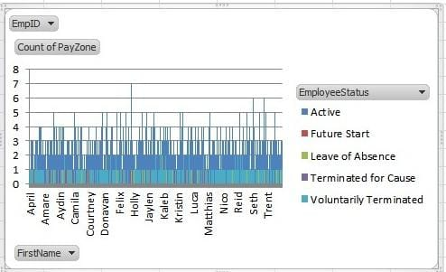
RESULTS :
The chart displays a column chart representation of employee attendance status over various individuals, helping to quickly identify patterns in employee availability and turnover.
11

Slide 12
Conclusion :
Visualizing employee attendance trends using Excel tables and charts shows clear and actionable insights for the effective decission .
BENEFITS :
Improves the operational efficiency by using these data-driven analysis and reduces manual errors .
Imporves the ability to forecast and manage attendance-related challenges, optimizing workforce planning.
Future Implications:
Continue use of visual presentation will enable more strategic planning in effective way .
Incorporating extra datas and advanced analytics can further helps the insights and enhance predictive capabilities.

